Slide 1
Taxonomic classification of ants (Formicidae) from images using deep learning
Marijn JA Boer
marijn.boer@naturalis.nl
February 6th, 2018
Supervisor: dr. Rutger Vos

Slide 2
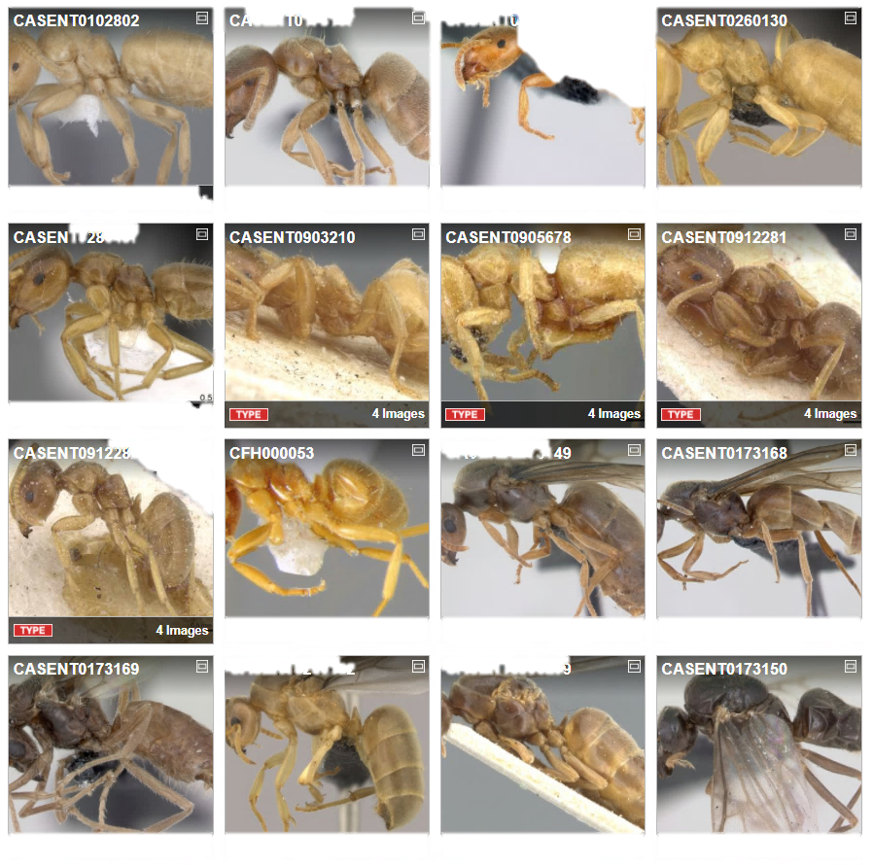
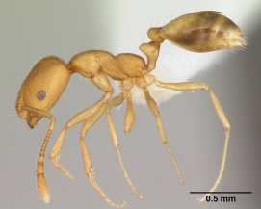
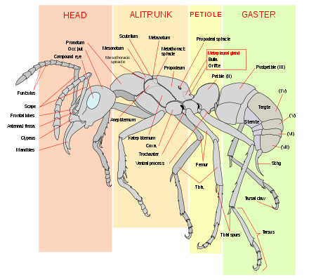
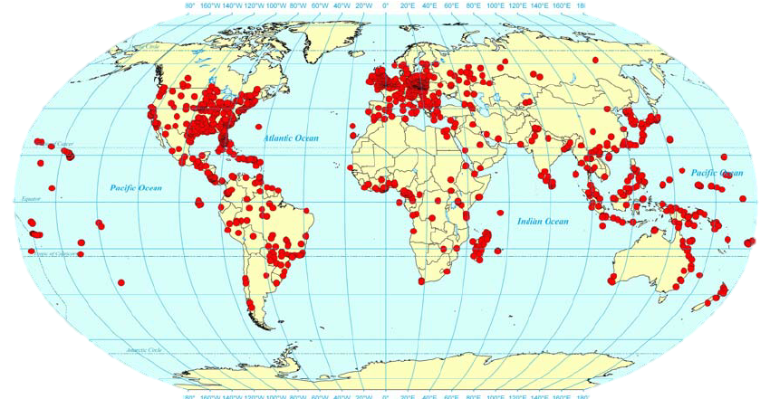
Ant Taxonomy
Global
Diverse
Identification
Monomorium pharaonis
Source: https://en.wikipedia.org/wiki/Ant
Wetterer JK. Worldwide spread of the pharaoh ant, Monomorium pharaonis (Hymenoptera: Formicidae). Myrmecological News. 2010;13: 115–129.
Photo by April Nobile / From www.antweb.org. Accessed 31 January 2018
AntWeb. Available from: https://www.antweb.org/images.do?rank=species&name=flavus&genus=lasius. Accessed 31 January 2018

Slide 3
Important to know the species
Insight
Conservation
Ecosystems
Biodiversity

Slide 4
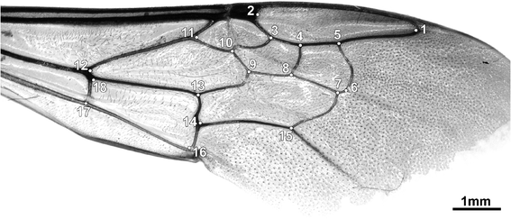

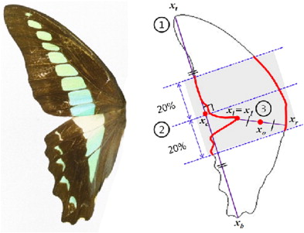
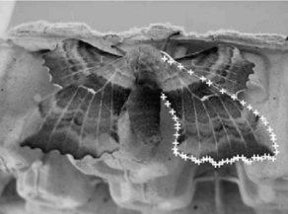
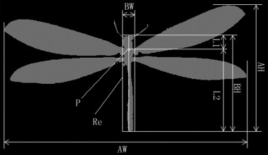
Computer vision
Machine learning
Learns on introduced features
Gerard, M. et al. Apidologie 46, 644–653 (2015)
Watson, A. T. et al. Syst. Biodivers. 1, 287–300 (2004)
Kumar, N. et al. in Computer Vision – ECCV 2012 502–516 (2012)
Kang, S.-H. et al. J. Asia. Pac. Entomol. 15, 431–435 (2012)
Wang, J. et al. Knowledge-Based Syst. 33, 102–110 (2012)

Slide 5
https://blogs.nvidia.com/blog/2016/06/29/deep-learning-6/

Slide 6
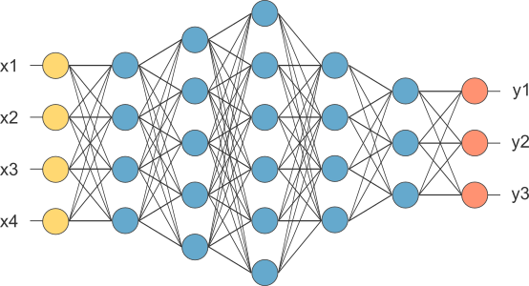
Deep learning
More promising
Higher accuracy
Feature learning
http://www.opennn.net/images/dep_neural_network.png

Slide 7
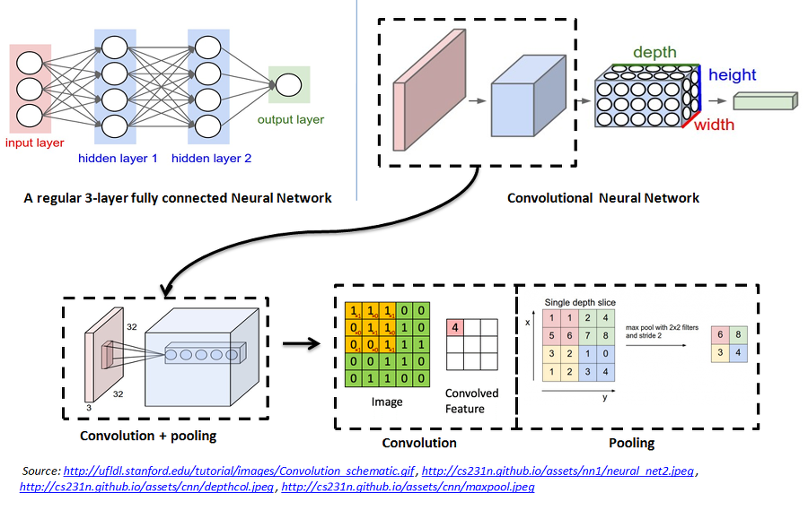
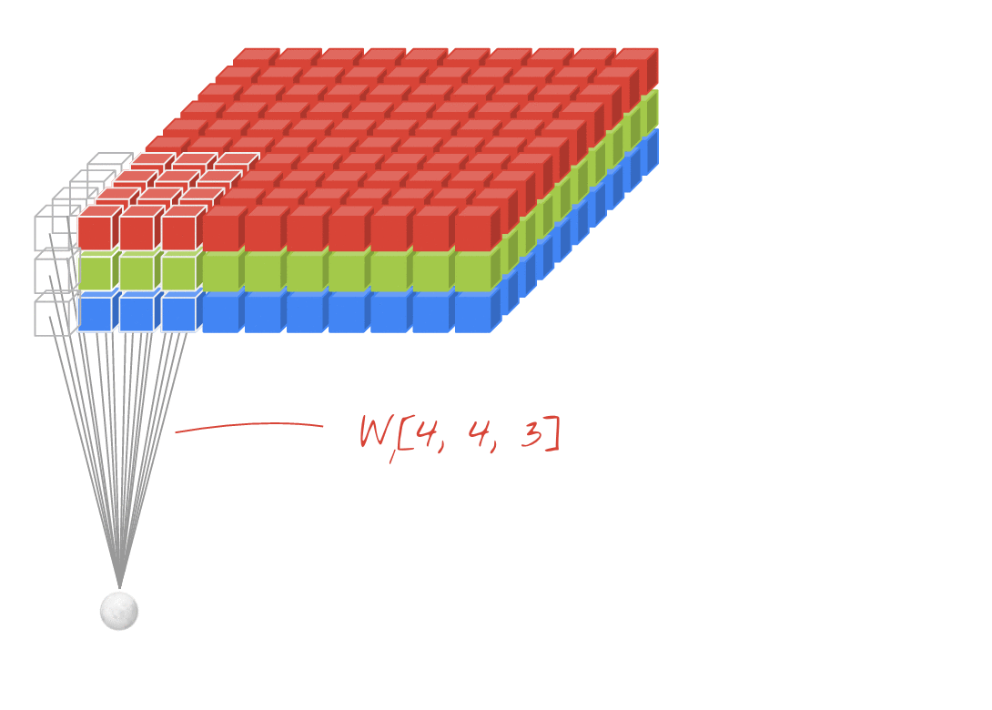
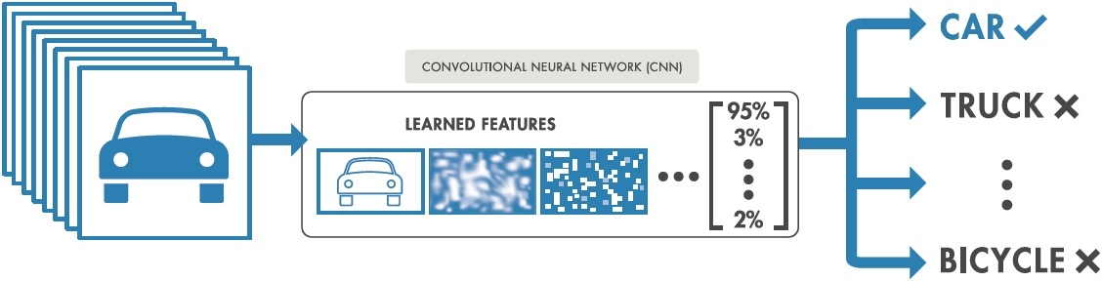
Convolutional neural network
1 | 0 | 1
0 | 1 | 0
1 | 0 | 1
https://nl.mathworks.com/content/mathworks/nl/en/discovery/convolutional-neural-network/_jcr_content/mainParsys/image.adapt.full.high.jpg/1508999492829.jpg
https://codelabs.developers.google.com/codelabs/cloud-tensorflow-mnist/#10
https://github.com/Kulbear/deep-learning-nano-foundation/wiki/ReLU-and-Softmax-Activation-Functions

Slide 8
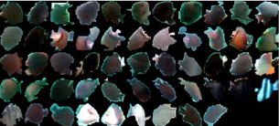
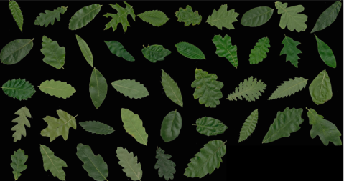
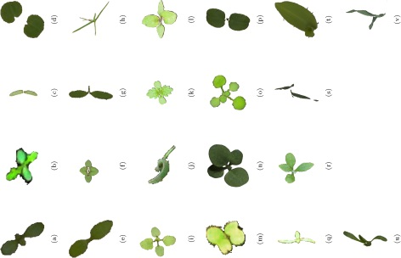
DL examples
Deep-Fish: 98.64%
Deepplant: 99.5%
Weed/crops: 86.2%

Slide 9

FormicID
Starting project…
Project is set up.
https://github.com/naturalis/FormicID

Slide 10
Aim
Explore the possibilities on automatic insect identification using DL.
Naturalis’ goal of initializing an image classification system for own use.
In order to also explore the CNN-field a trial will be started to incorporate a "three type view per specimen" approach.

Slide 11
Question
Can ants pecies be discriminated from images using deep learning?
Will three shot types classify species more accurately than a single shot view?
Which shot type will classify species more accurately?
Which image quality has the best accuracy vs training speed?

Slide 12
Approach
Creating a dataset
Neural Network training
Neural network testing

Slide 13
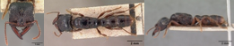
AntWeb

Slide 14
FormicID-97
97 species
Minimum of 68 images
10,204 images
Dataset
Test set
Test set
Training set
Validation set
Training set

Slide 15
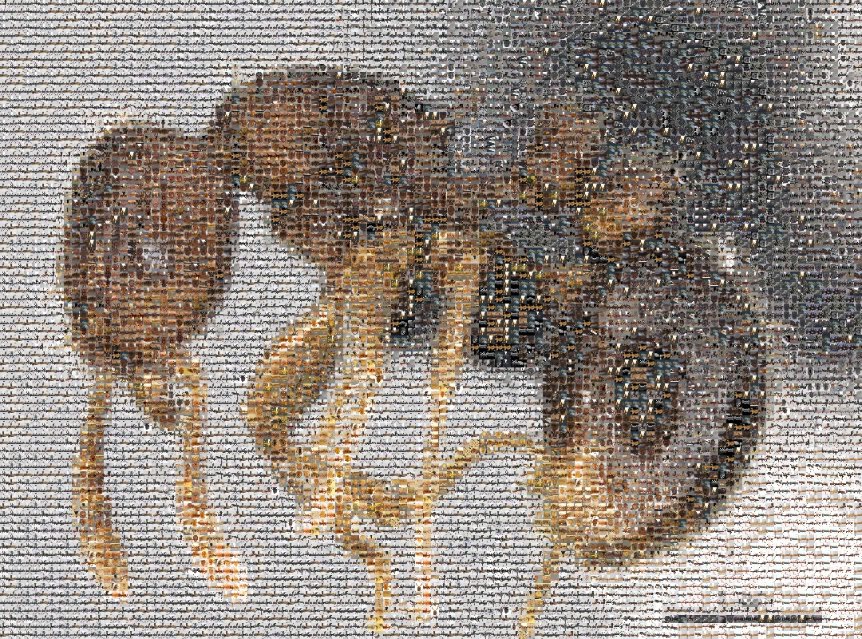
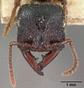

Slide 16
Species distribution

Slide 17
Shot type distribution

Slide 18
Image dimensions

Slide 19
File size

Slide 20
Network architecture
Potiential NNs
Design a NN
ResNet
He, K.et al. inarXiv preprint arXiv:1603.05027(2016)
Inception v.4
Szegedy, C.et al. arXiv preprint arXiv:1602.07261(2016)
Xception
Chollet, F. in arXiv preprint arXiv:1610.02357(IEEE, 2017)
DenseNet
Huang, G.et al. arXiv preprint arXiv:1603.09382v3(2016)
Python
Keras
https://github.com/fchollet/keras
Algorithms
Dropout
Srivastava, N.et al. Journal of Machine Learning Research15, 1929–1958 (2014)
NADAM
Dozat, T. ICLR Workshop (2016)
Batch Normalization
Ioffe, S.et al. arXiv preprint arXiv:1502.03167v3(2015)

Slide 21
Testing
Top 5 accuracy
Top 1 accuracy

Slide 22
Timeline

Slide 23
Timeline

Slide 24
Thank you for your attention!
Contact: marijn.boer@naturalis.nl

